Slide 1
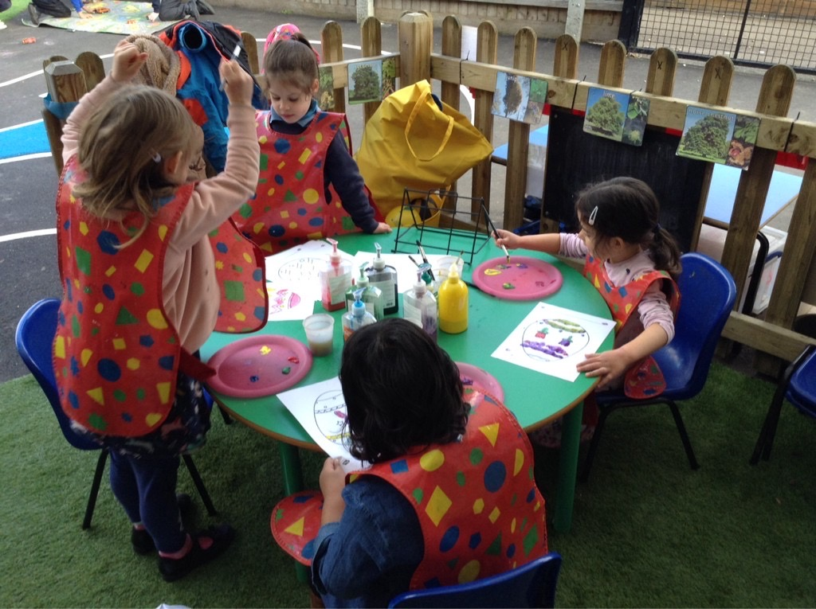

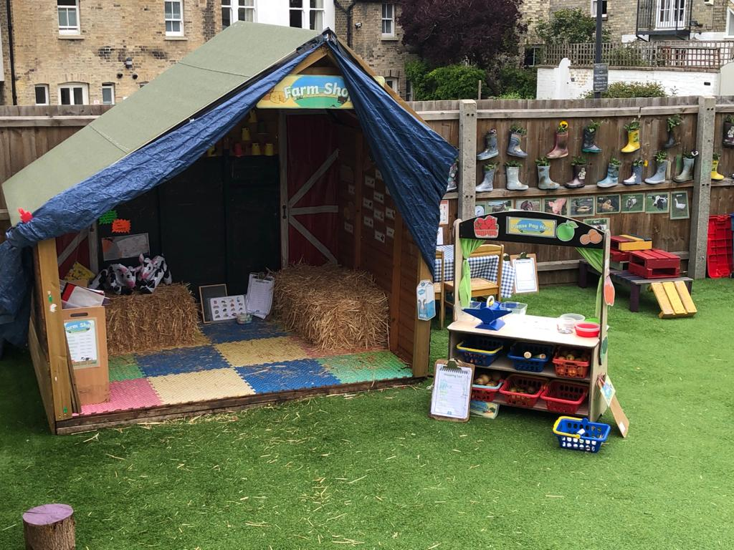
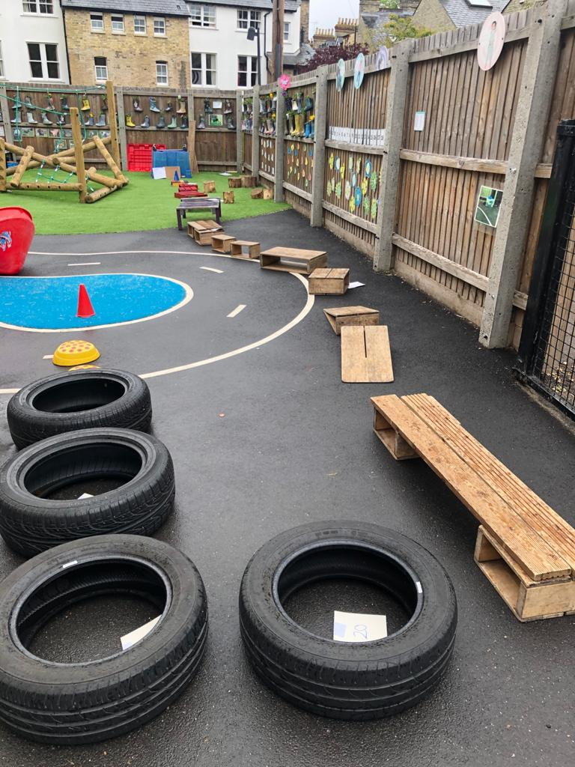
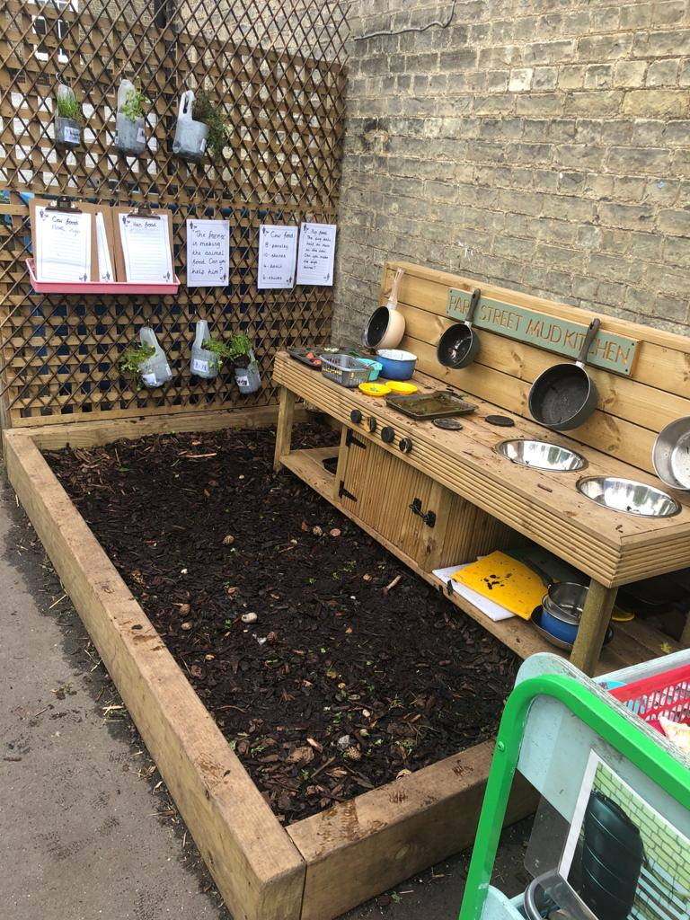
Reception Induction Meeting
For Parents and Carers 2024

Slide 2
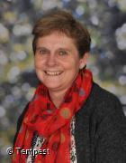
Welcome – Mrs Hawker

Slide 3
At Park Street C of E Primary School our strengths are:
The positive relationships established between staff, governors, children and the school community as a whole
Our values: Honesty & Respect, Friendship
& Kindness, Learning and Fun
The high-quality education we provide to all children
The happy, safe and secure learning environment
Providing an educational experience within the context of Christian beliefs and practices.
Notes:
Mrs Hawker

Slide 4
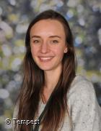
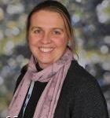

Staff in Class 1 – Owl Class
Teachers:
Teaching Assistants: Mrs Borbas
Mrs List
Mrs Shankland
(1afternoon)
Miss Erens
(1 afternoon)
Notes:
SH

Slide 5
Classroom Visit – Stay and play
You are invited to visit us at Park Street C of E Primary School on:
  Monday July 1st (9.30-10.30am)
  Thursday July 11th (2:00-3:00pm)
During these sessions we will encourage the children to stay and play in the classroom and meet their new friends and teachers. Adults will be offered a chance to meet other parents in the hall and have a drink. Adults must stay on-site.
Notes:
KS

Slide 6
Home Visits
Teachers are planning to visit your child at home in the days before they start school.
These visits help greatly in the settling process, enhancing the relationship between the setting and the home, and so benefiting both the child, parents/carers and staff.
The visits allow us to share information, ask and answer questions and get to know one another.
Meeting practitioners in their own home, where they feel secure, is reassuring for the children.
Notes:
KS

Slide 7
Timeline for Starting School
Week beginning Monday 2nd September –
  Thursday 5th – Year 1 only
  Friday 6th and Monday 9th – Home visits
  Tuesday 10th – Reception group 1
  Wednesday 11th – Reception group 2
  Thursday 12th – Reception group 3
  Friday 13th – all children in for the morning.
Children will be at school from 9:00am until 11:45am
Notes:
KS

Slide 8
Timeline for Starting School
Week beginning Monday 16th September –
  All children will be in school for the morning and will stay at school for lunch.
  School lunch is provided free to all children in Reception, Year 1 and Year 2.
  School hours: 9:00am until 12:30pm.
  Collection at 12:30pm everyday this week.
  Please ensure your child is school ready for lunchtimes. They must be able to feed themselves.
Notes:
KS

Slide 9
Timeline for Starting School
Week beginning Monday 25th September -
  All children will be in school every day for the whole day: 8.45am – 3:15pm
If you/we feel your child is not ready for full time school, we will talk together about a reduced timetable.
Notes:
KS

Slide 10
Welcome to the Early Years Foundation Stage (EYFS)
The EYFS is the stage of education for children from birth to the end of the Reception year.
It is based on the recognition that children learn best through play and active learning.
Aims of the Reception year:
To continue developing skills as a learner
To unlock children’s potential
To foster independence, interest and enquiry
To make friends
To learn how to get on with others and solve conflict appropriately
To become ‘schoolised’ (not institutionalised!)
Notes:
KS

Slide 11
Characteristics of Effective Learning
Playing and exploring – engagement
Finding out and exploring
Playing with what they know
Being willing to ‘have a go’
Active learning – motivation
Being involved and concentrating
Keeping trying
Enjoying achieving what they set out to do
Creating and thinking critically – thinking
Having their own ideas
Making links
Choosing ways to do things
Notes:
KS

Slide 12

The 7 Areas of Learning…
The Foundation Stage Curriculum:
PRIME AREAS
Personal, Social and Emotional Development
Communication and Language
Physical Development
These are crucial for developing children's curiosity and enthusiasm for learning.
SPECIFIC AREAS
4. Literacy
5. Mathematics
6. Understanding the World
7. Expressive Art and Design
Notes:
CL

Slide 13
Learning Themes
We learn through topics each half term:
Autumn Term Topics:
Autumn 1 – Ready, Steady, Go!
Autumn 2 – Trip to a Museum
Spring Term Topics:
Spring 1 – Up, Up and Away
Spring 2 – Potty About Plants/ Dragons and Giants
Summer Term Topics:
Summer 1 – We Are World Explorers
Summer 2 - I Do Like to Be Beside the Seaside
Notes:
RM

Slide 14
A typical day in Owl Class
Children come in by themselves and self-register
Self-select activities available, initially free choice, leads into carousel of key phonics and maths activities when children are ready
First carpet time – English
Child initiated play
Playtime (water bottle needed, fruit snack provided)
Phonics
Second carpet time – maths focus
Child initiated play
Lunchtime - Play on Jesus Green – when we’re ready
Afternoon carpet time then child- initiated play
Story-time/fine motor activities/circle time
Home-time: Children are collected from the classroom (playground exit), they show the teacher who their parents/ carers are before leaving
All children should leave the school with their adult
Notes:
KS

Slide 15
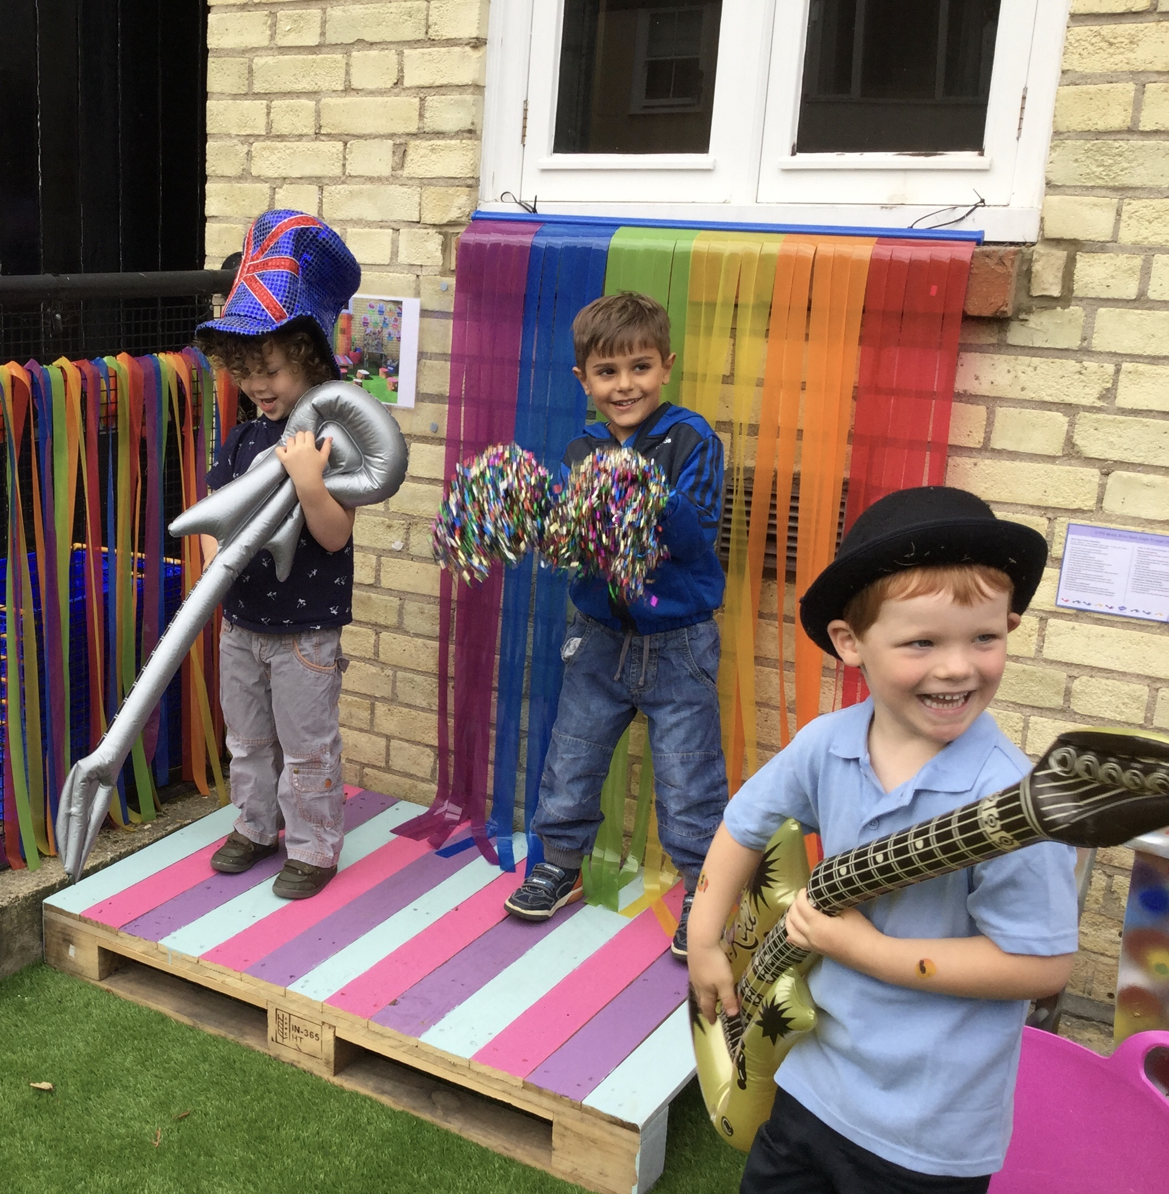
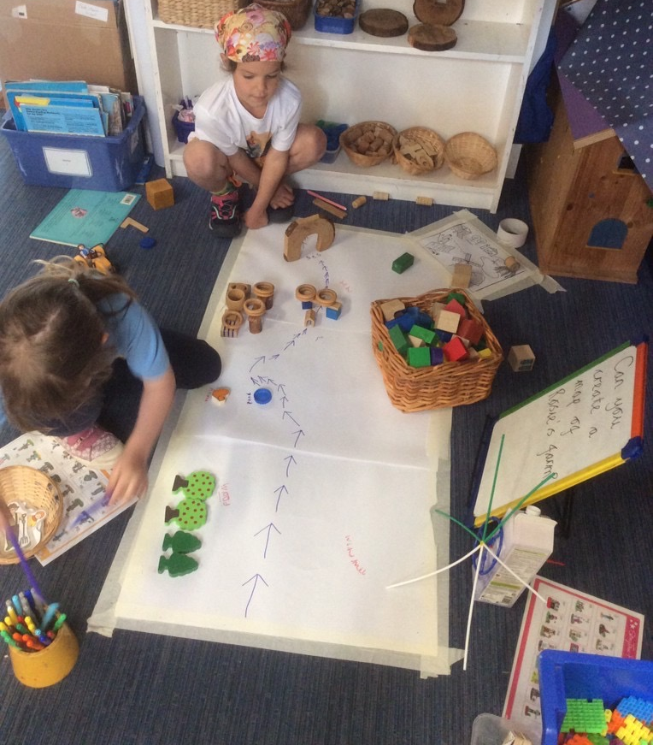
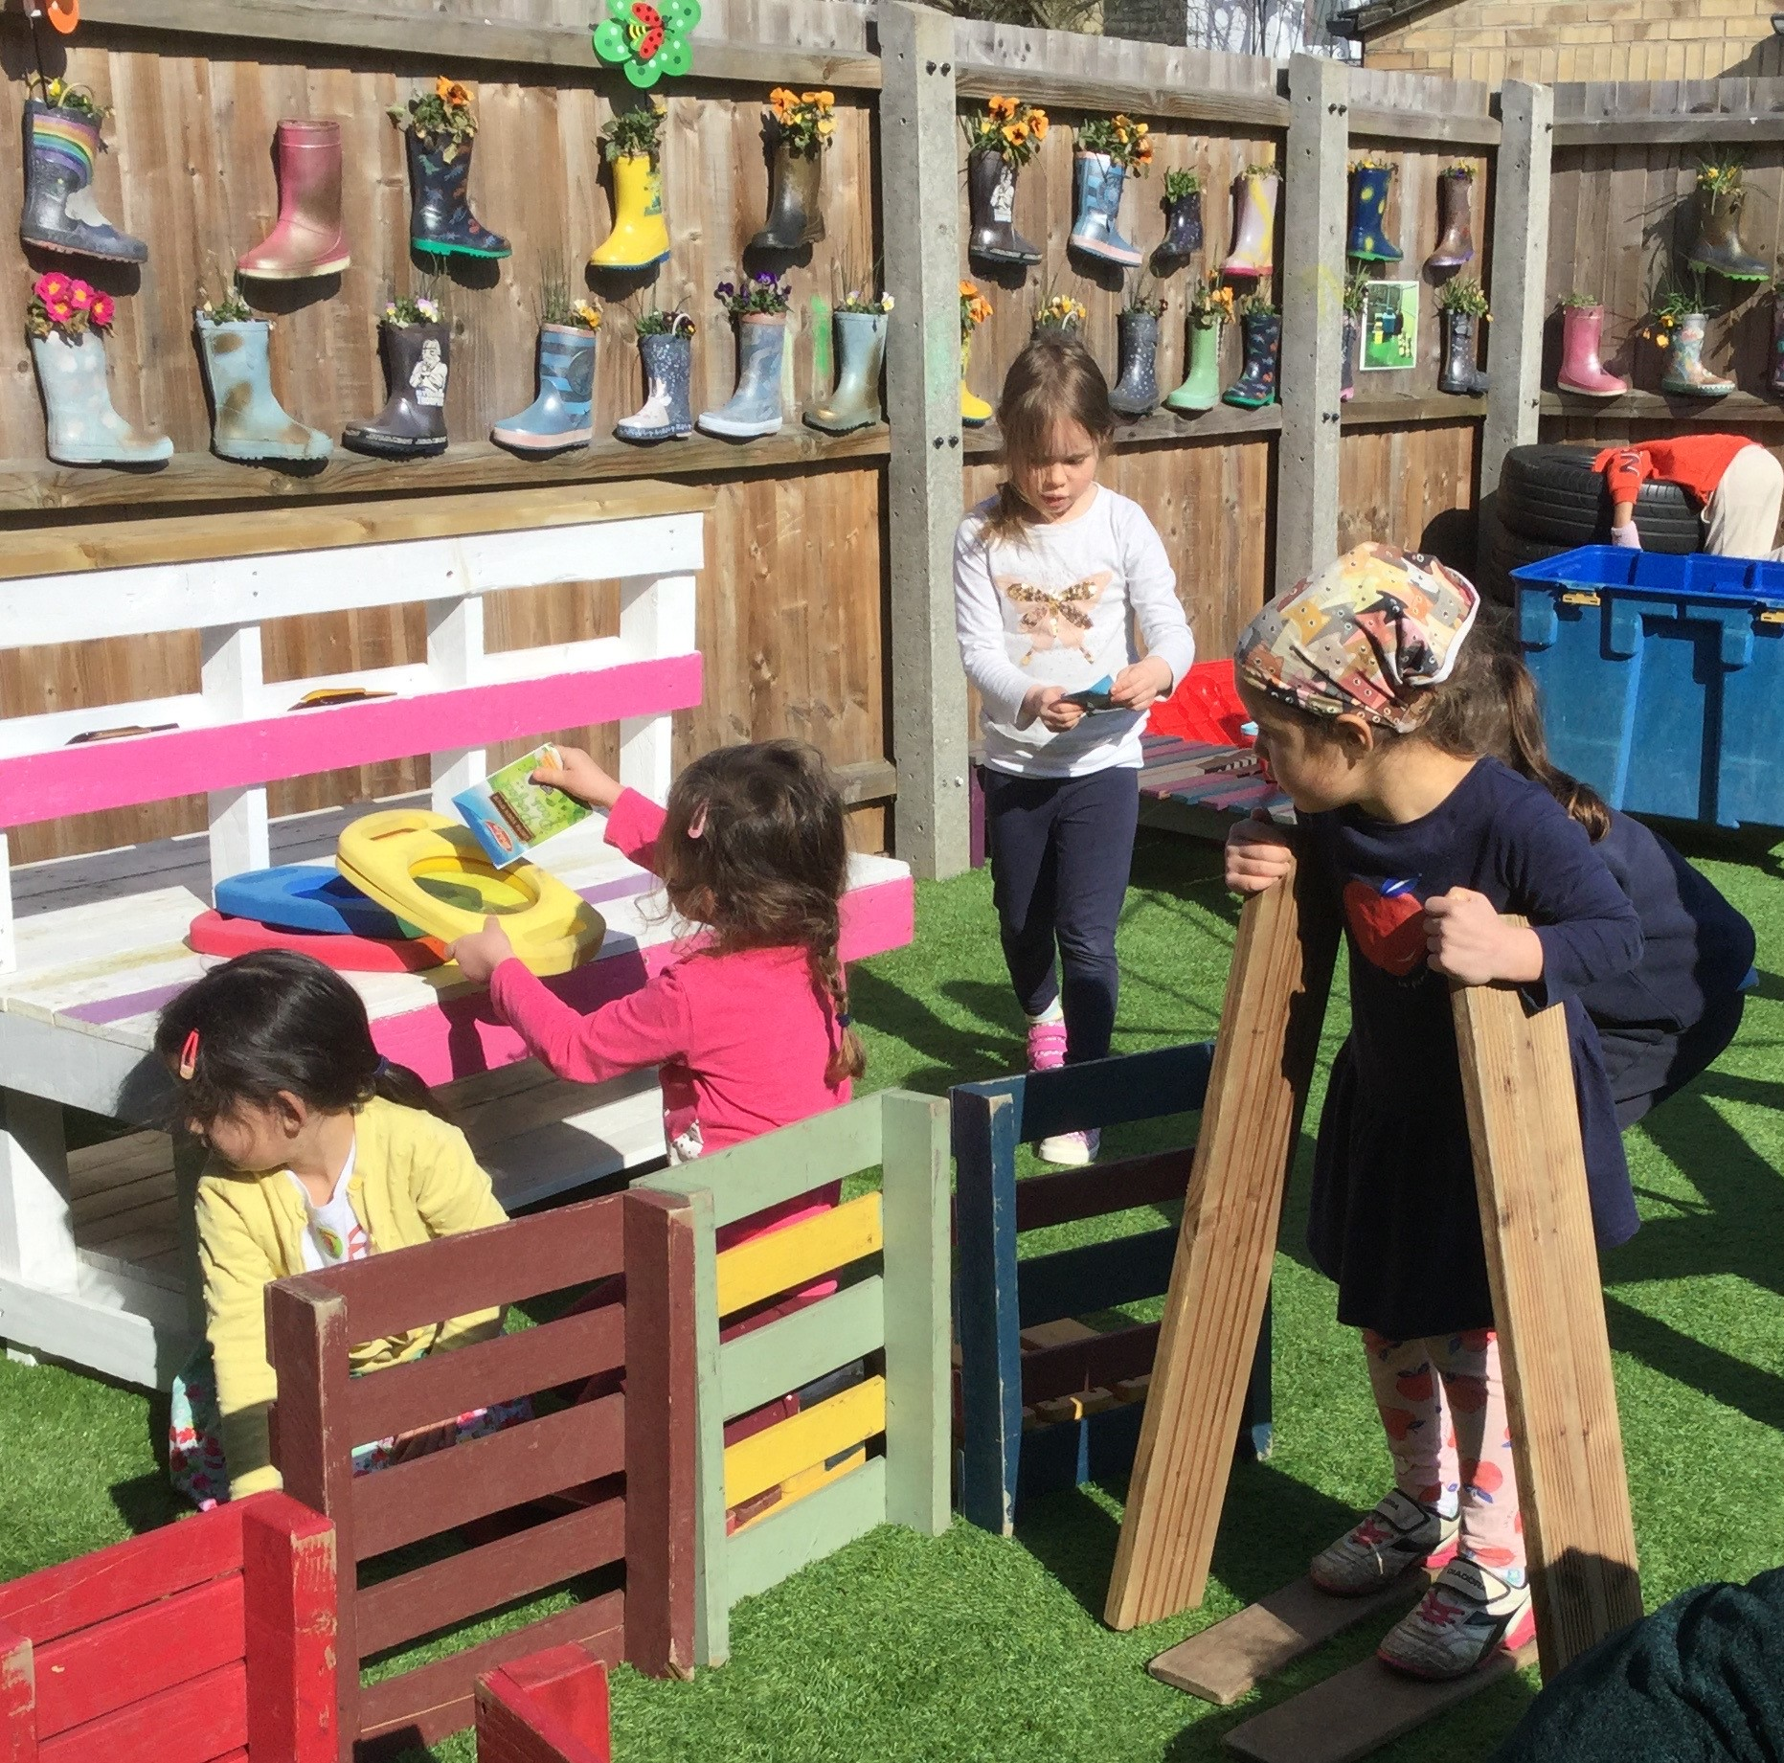
Typical Child Initiated Opportunities
Free flow during CP inside and out
Adventure shed
Giant and small loose parts
Waterplay and mud kitchen
Bikes
Small world play
Message centre
Reading opportunities
Messy play
‘Busy Fingers’
Creation station
Develop independence and self-awareness
Notes:
KS

Slide 16

This is a consistent and rigorous programme, with the aim to teach EVERY child to read and write
Children learn 44 sounds (phonemes) and the corresponding letter/letters
They learn to read words using segmenting (sounding out each individual sound) and blending (putting all the sounds together to form the whole word)
The children read lively stories using the words they have learned
There will be a phonics meeting for parents during the school day in the first half term
Notes:
CL

Slide 17
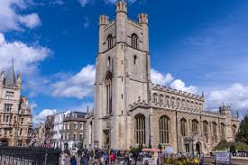
Religious Education
We are a Church of England primary school
We aim to serve the community by providing an education of the highest quality within the context of Christian beliefs and practices.
We promote Christian values through the experience we offer all pupils
We have a link with Great St. Mary’s Church in Cambridge and other local churches
We have a daily act of collective worship and we explore our feelings and beliefs through weekly RE and PSHE lessons.
Notes:
CL

Slide 18
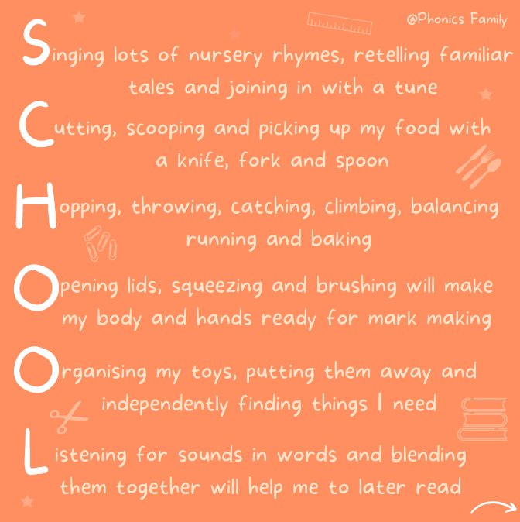
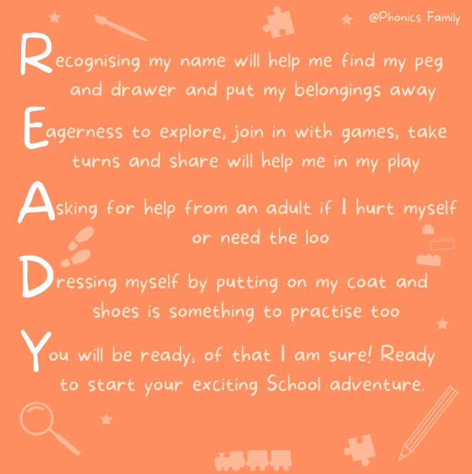
What can you do to help your child’s learning when they begin school?
Notes:
SH

Slide 19
What can you do to help your child’s learning when they begin school?
Help develop independence- getting themselves dressed, going to the toilet, feeding themselves
Sharing books, talking about the pictures
Reading Book, make comments in their reading diary
Read/share books at least four times per week
Ongoing - encourage mark making, shopping lists, writing postcards, letters etc. Please do not teach capital letters to start with, only lowercase.
Encourage children to talk, ask and answer questions
Practise Maths at any time – counting, looking for numbers in the environment, identify shapes and patterns
Play simple board games
Sing number rhymes and songs together
Support any homework that comes home, sounds and number work
Talk to us and keep us updated!
Notes:
SH

Slide 20

What can you do to help your child’s learning when they begin school?
Notes:
SH

Slide 21
Home/School Communication
Fears and worries – please come and talk to us! You know your child better than we do!
Tapestry
Partnership – we believe in working together
Parents’ Consultations
Reading Records
Reading books, phonics activities, maths mat
PTA – coffee mornings
Notes:
KS

Slide 22

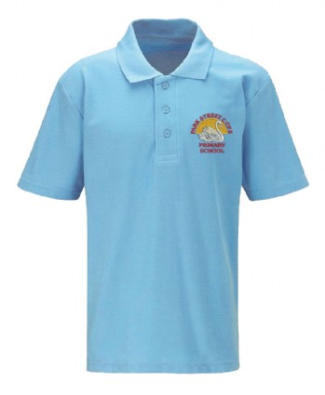

Clothing
We are have a simple school uniform
White, sky blue or navy polo shirt (doesn’t have to be branded)
Black or navy joggers, leggings, skirts, pinafores, trousers
Navy sweatshirt needed for PE but could be worn everyday or navy cardigan or fleece
In warm weather children will be most comfortable in shorts or blue gingham dresses
Click HERE for Mapac Uniform Website
Notes:
SH

Slide 23
Clothing
Please ensure children wear appropriate clothing and that names are in EVERYTHING!
Send coats EVERYDAY (preferably waterproof) and waterproof trousers in winter
Sensible shoes – no laces if possible
No jewellery (unless for religious reasons)
On PE day please come to school in PE kit – we will let you know when it is during home visit
A pair of wellington boots, named, to stay in school
Hair MUST be tied up if it is shoulder length or longer
Notes:
CL

Slide 24

The First Few Days ...
There can be a lot to remember in the first few days, but please do not worry as your child will quickly be teaching you the routines!
Book bag everyday
Tired!
Water bottle (named)
All clothing named!
Lunch box everyday (if having packed lunch)
Free fruit in the morning
Notes:
CL

Slide 25
Other matters…
Please let us know if someone different is collecting your child!
Medical
Current Covid-19 guidance; stay at home if you have symptoms, get a PCR test and let us know as soon as they have symptoms. Children can return 3 days after a positive test as long as they are symptom free.
Any sickness or diarrhoea must be followed by at least 48 hours absence
Head lice are common! Please check regularly and treat as recommended
Any absence requires a telephone call to the school office by 9:15am
Any prescribed medication can only be administered by prior arrangement with the school office and completion of a form
Notes:
CL

Slide 26

Summer Fair
Come join us on Saturday 22nd of June at Jesus Green for our school summer fair! It's a great opportunity to meet more parents and for your child to meet new friends.

Slide 27
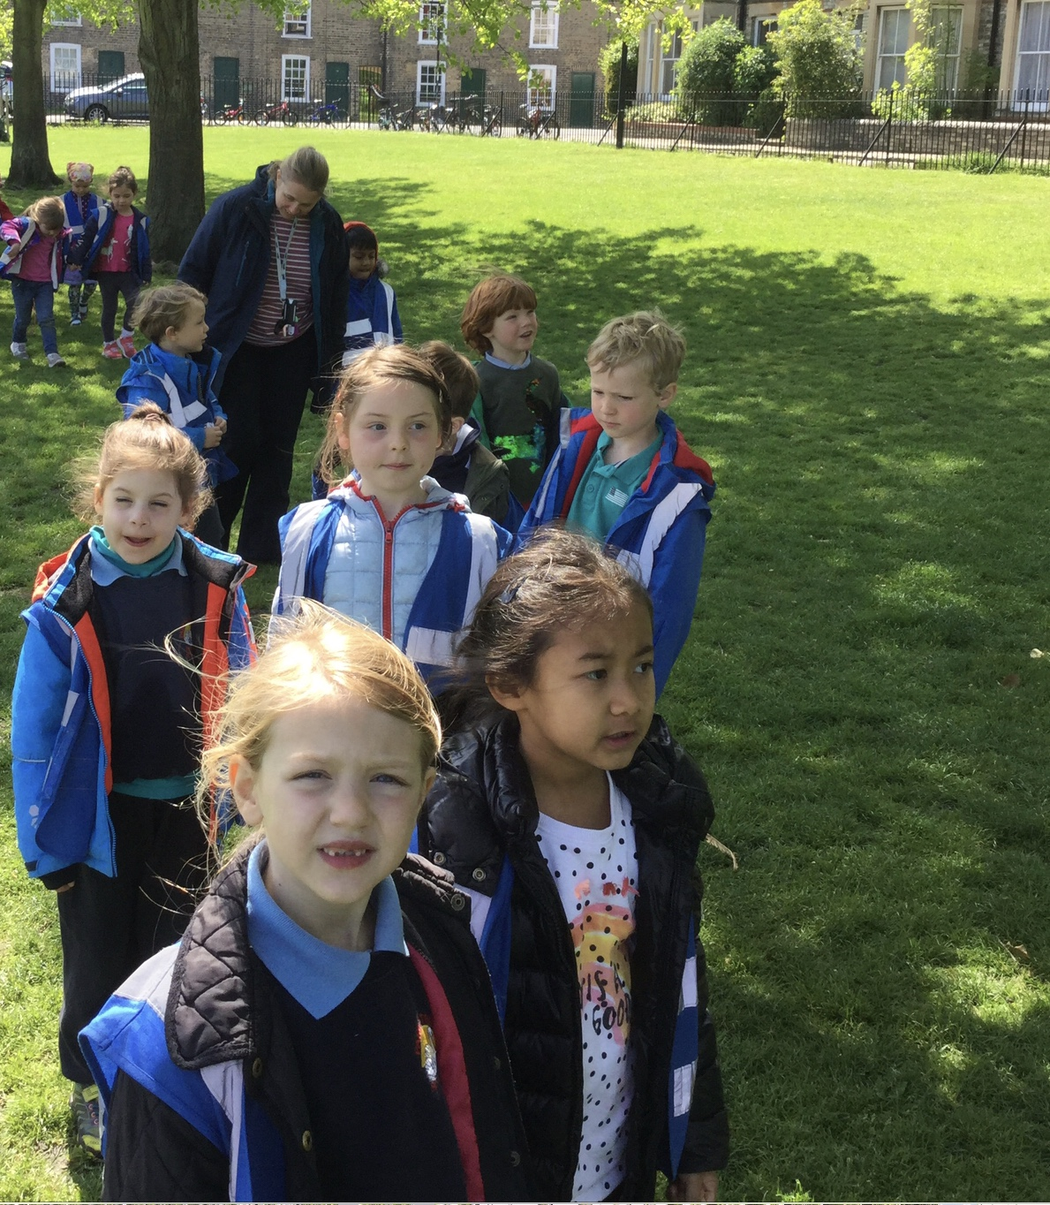
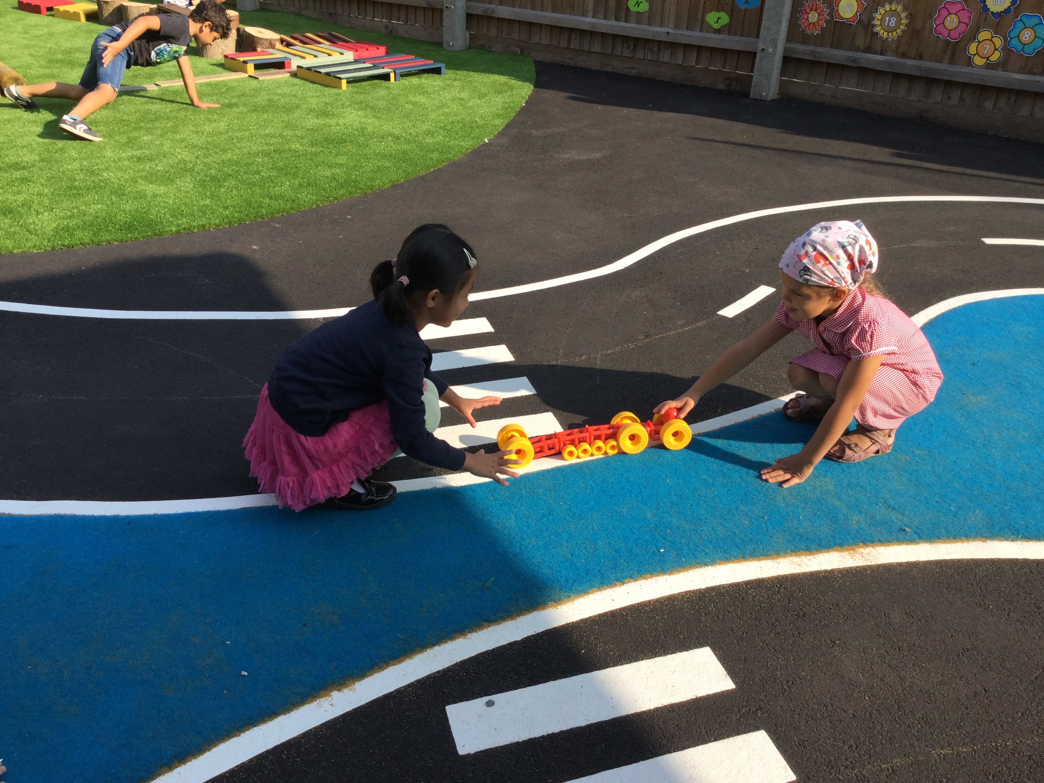
Any questions?

Slide 28
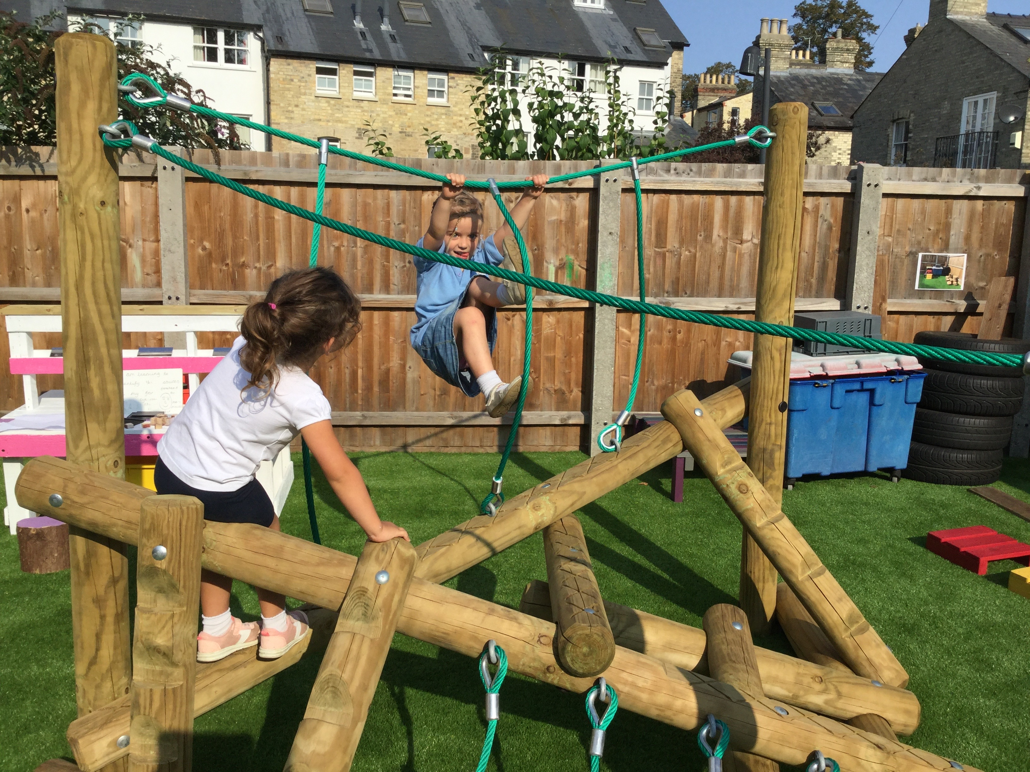
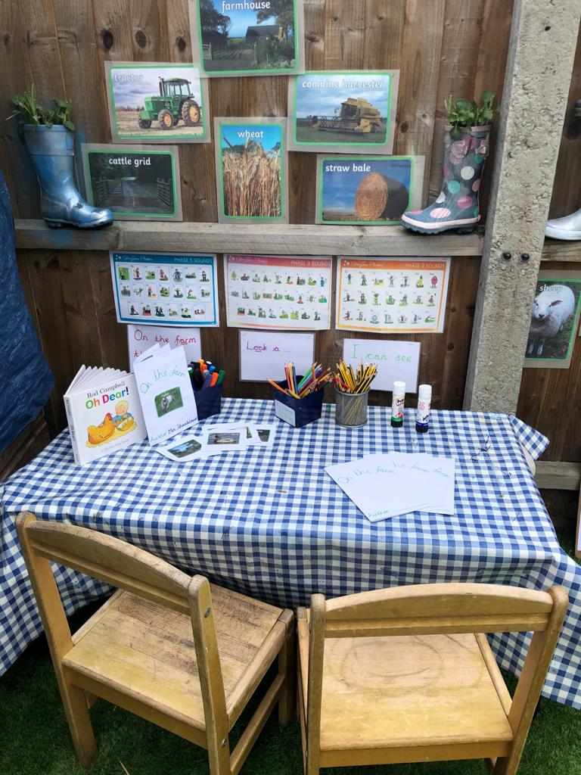
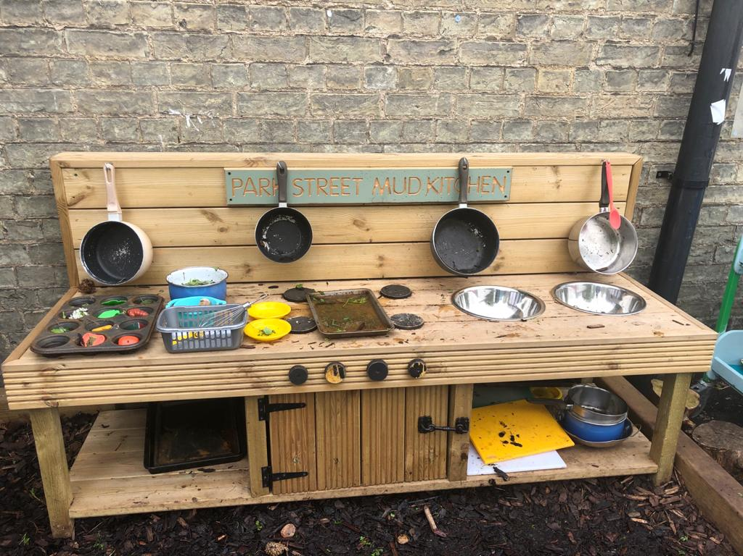
Thank you
We look forward to a happy partnership in your child's first year at school and beyond!

